Slide 1
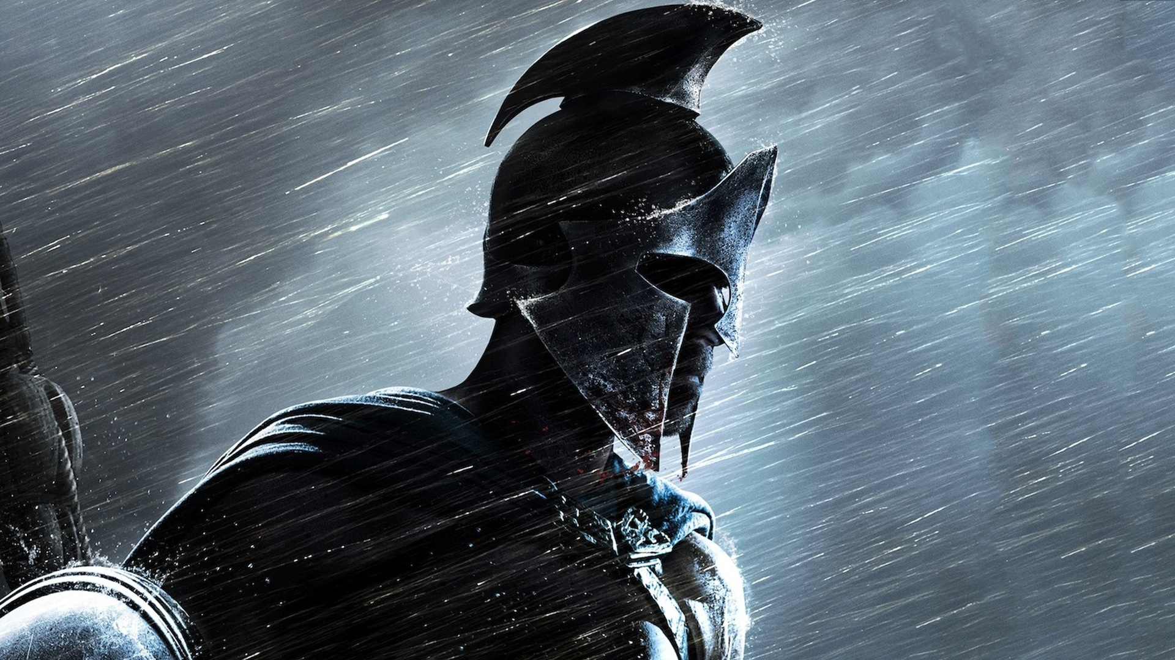
Sparta
Leading city state

Slide 2
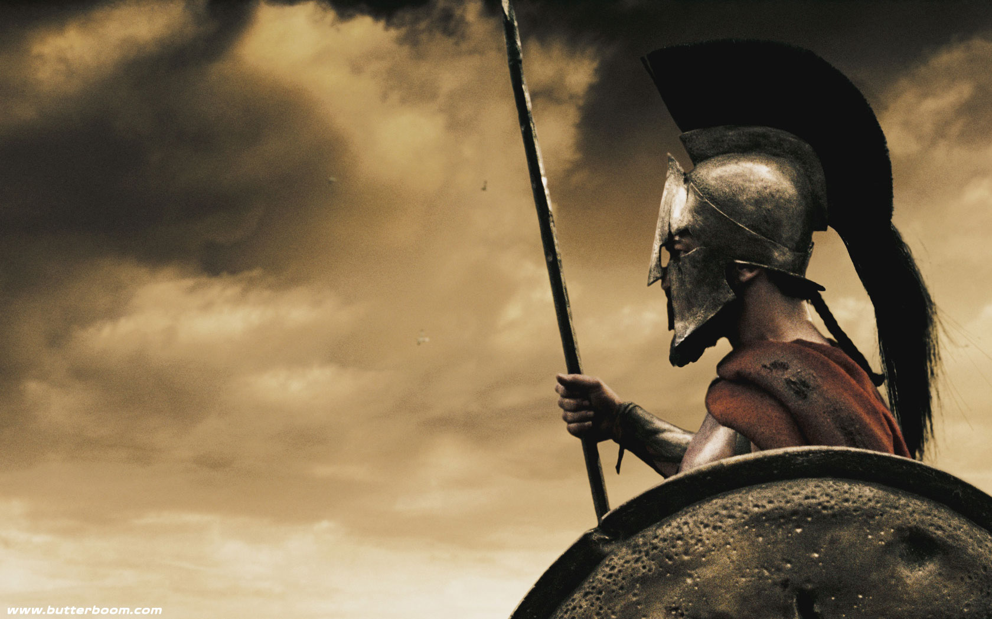
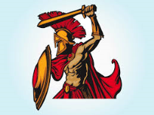
The City State of Sparta

Slide 3
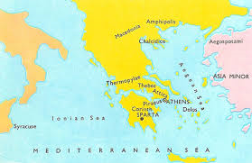
This Is Sparta!!!
As you all know that The Greeks always
Fought with each other, they broke into
City states. In this presentation You will see
And witness the details the life in a Spartan community. Each citizen would train to be a soldier. Girls were also taught to fight ,lie, steal and Kill!
This is Sparta!

Slide 4
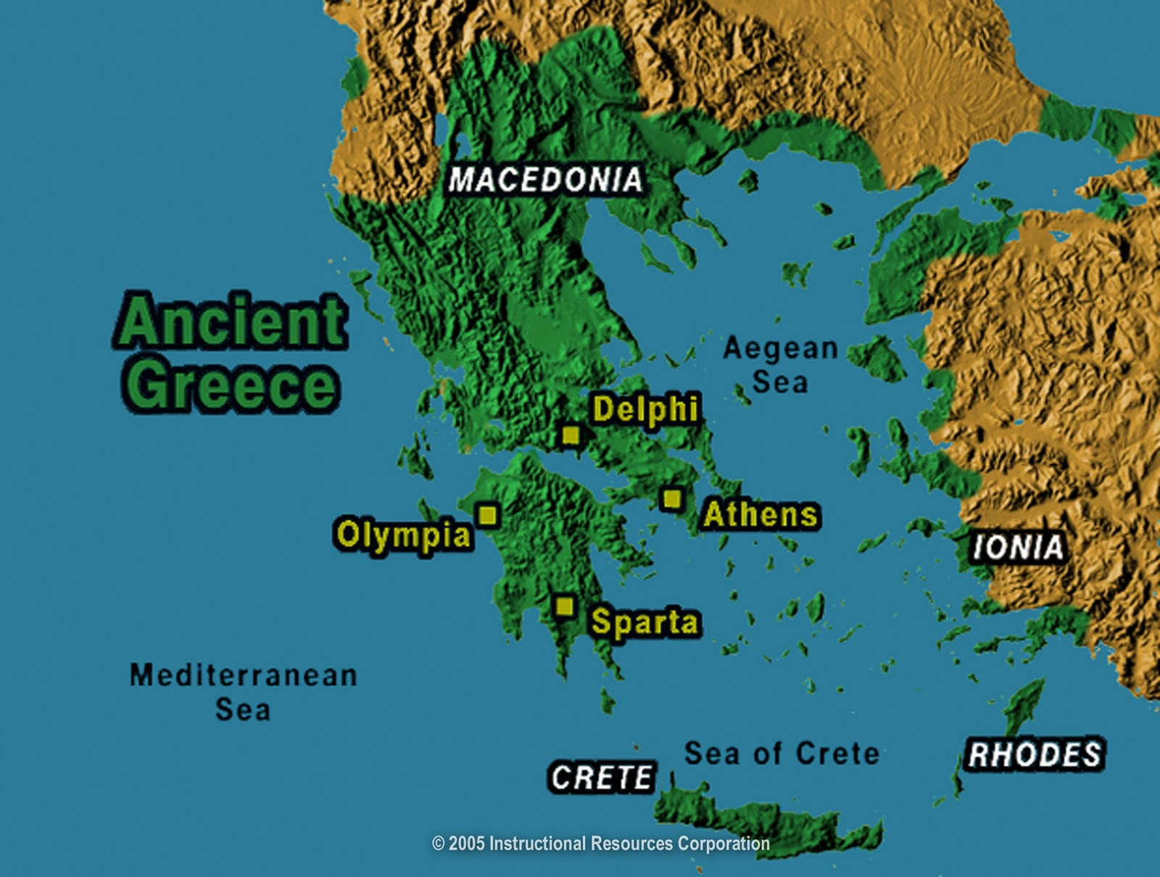
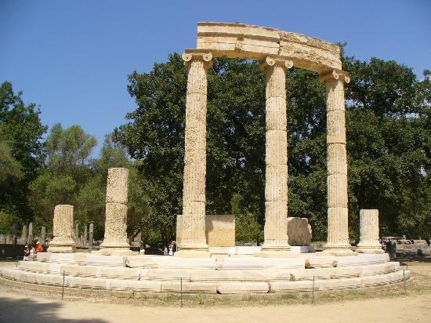
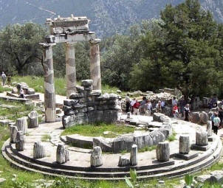
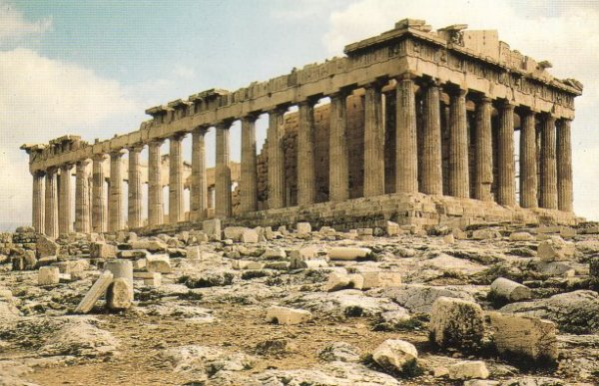
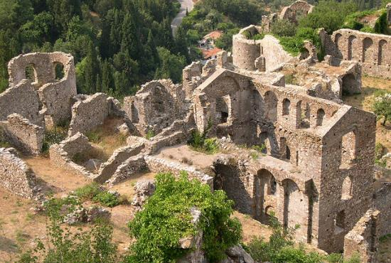

Slide 5
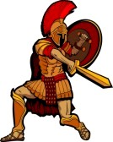
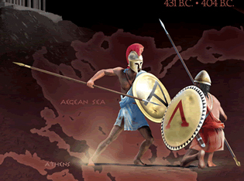
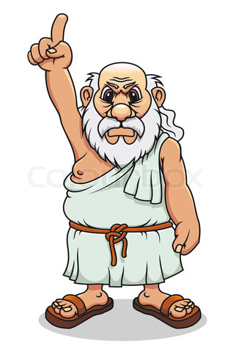
The Savage Spartans
One of the city state to grow after the dark ages was Sparta. They stole from just anybody, and they moved into anybody’s farm or field, if somebody was living there, they just made them slaves. Of course people didn’t enjoy being slaves, so they talked to the Spartans in the only language they understood, Violence. Sparta was a dominant city state in Ancient Greece. Their big rivals was Athens, Corinth and Thebans.
You have a choice, give up all your land and possessions and become our slave or we will kill you!
HMM……
Tricky one

Slide 6
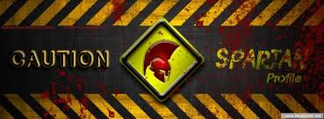
Sparta
Sparta is a very powerful city state which has a specialty. That is that they learn only How to fight and fight. The sons went to school at the age of 7, but they learnt only how to fight steal and lie. They served the military till the age of 60.
In Sparta if the baby was not healthy enough then they left him on the cliff of a hill. This was part of their culture.
Sparta has helped out Greece in almost all wars. They fought against Persia, Rome and many more countries who wanted to conquer their civilization. Sparta was ruled by victorious retired warriors.
Ares was the main god they worshiped in Sparta, Because he was the god of war and violence.

Slide 7
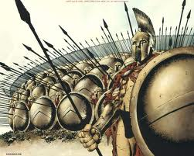
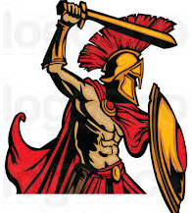
The Spartans
One ancient Greek writer wrote “Once, during the games at Olympia, an old man wanted to watch, but could not find anywhere to sit. He worked his way around the whole stadium, but nobody was willing to make space for him. When at last he reached the part of the stadium where the Spartans were sitting, all the young men and some older ones too stood up to offer him their places. Immediately the crowd cheered. As he sat down, the old man shook his head sadly and said, “It is such a tragedy that all the Greeks know what is right, but only the Spartans do it.”

Slide 8
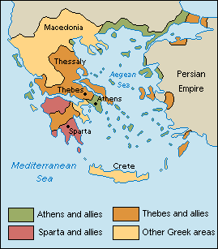
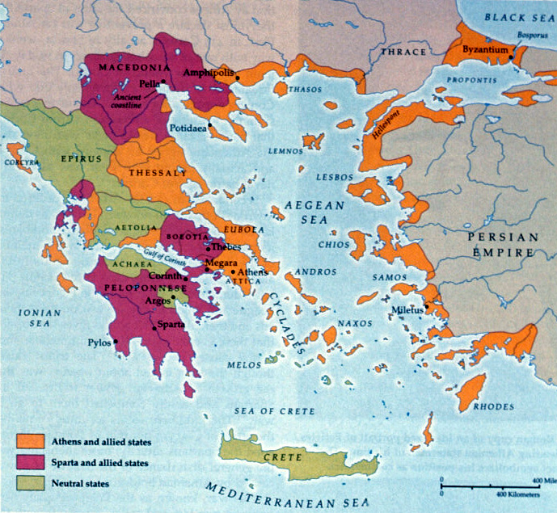
Geography
Sparta was a city state that dwelt next to the river Evrotas, which was located in the center of Peloponnese in southern Greece. Around 650 B.C. Sparta became a dominant Greek city state in military land power. Sparta was unique when compared to other Greek city states.

Slide 9
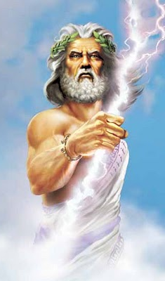
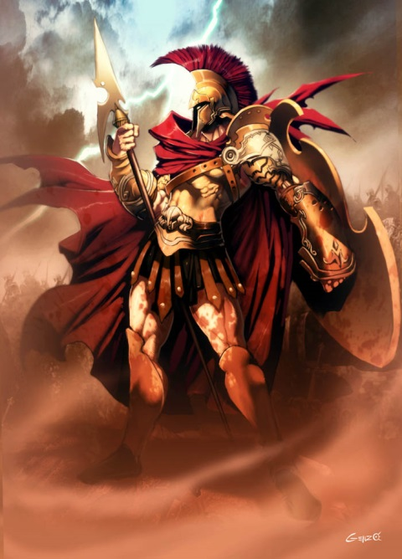
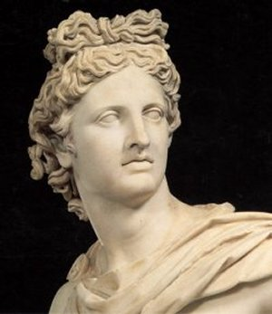
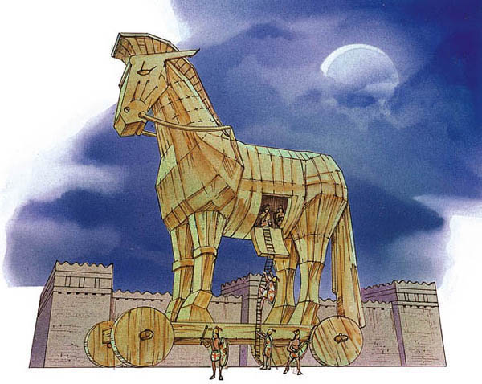
Mythology
In mythology, the founder of Sparta was Lacedaemon, a son of Zeus. Sparta was an important member in the ancient Greece force, which fought Troy. The ancient Spartans had two favourite Gods. They were the Greek god of war, Ares. And the Greek god of music, Apollo.

Slide 10
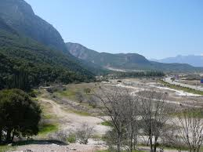
Spartan Wars
Sparta has helped out in many wars like the Trojan war, Thermopylae and many more.
The Thermopylae war
The Thermopylae war was when the Persians wanted to conquer the city state of Athens and so Athens asked Sparta to help them. This war took place in the Thermopylae pass where 300 Spartans and other warriors leaded by Leonidas took on more than a 1000 Persian warriors. The Spartans used the Phalanx position to battle the Persians.

Slide 11
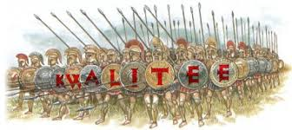
Phalanx Position of war.
In the Thermopylae war, The Spartans used the phalanx position.
The Phalanx position is when the first row sticks their spears out and closes their shield so that his neighbor is protected. The3 rest of the rows sticks their spears from the top or the bottom.

Slide 12
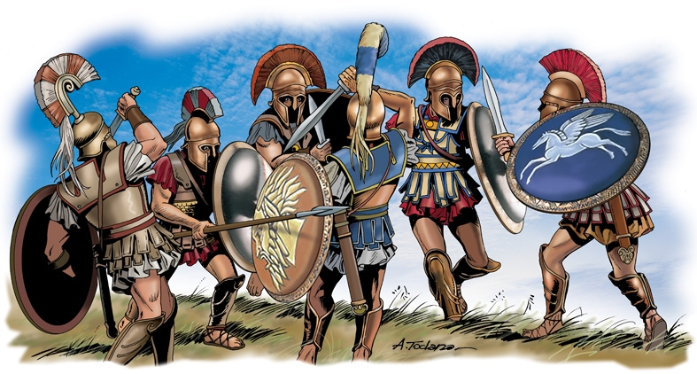
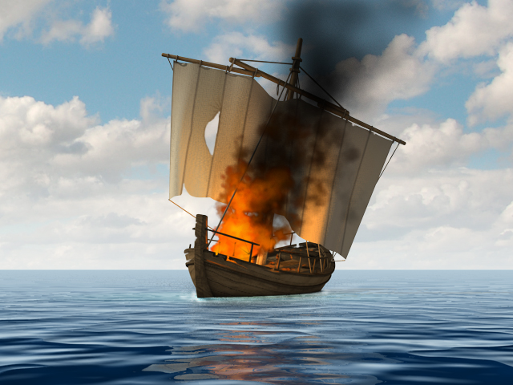
Athenian Conflict
Once there was an Athenian general called Alcibiades, who fought the Spartans. Once he was called back to Athens, because he cut noses from the statues of gods in the temples. Sensible Alcibiades just went back to Sparta, and told them all the secrets of the Athenian army!
The Peloponnesian war league results
Sparta & Syracuse united Athens
1
0

Slide 13
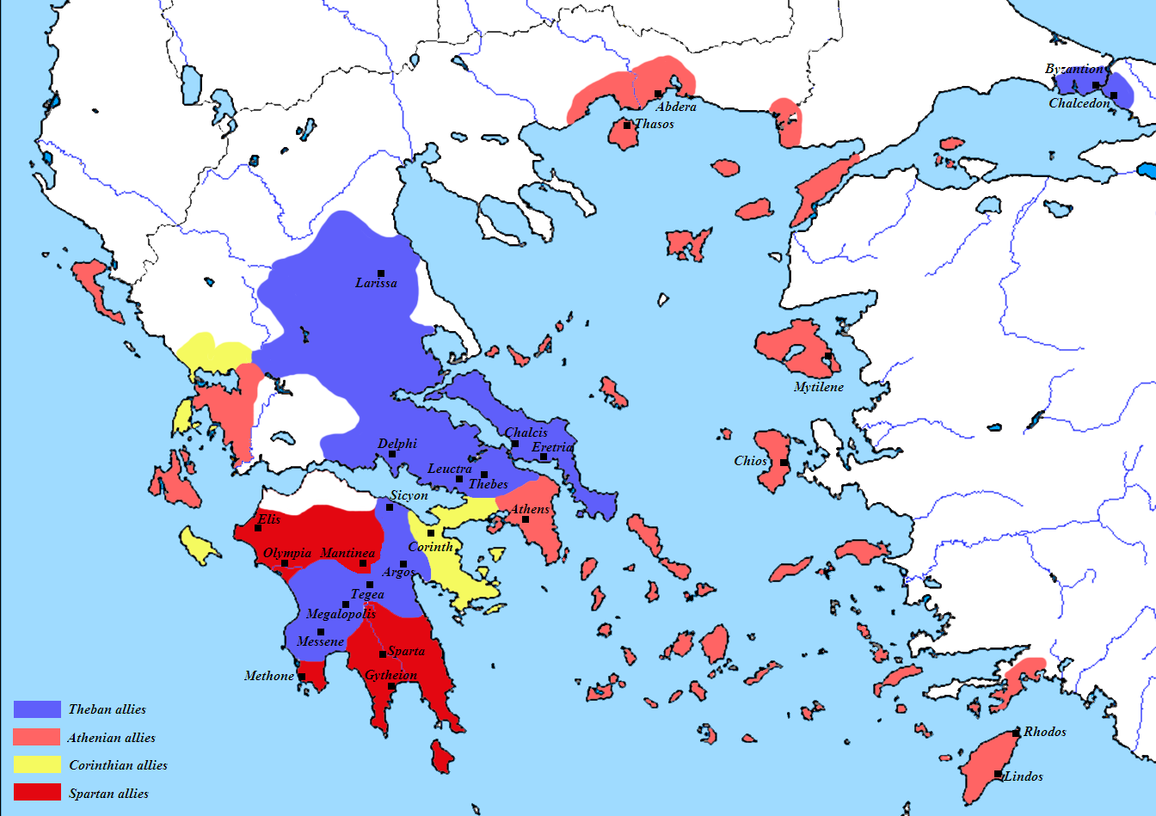
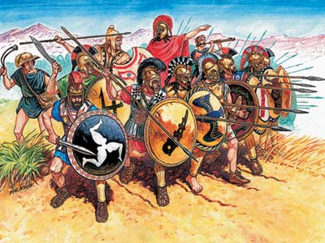
Corinthian war
This was when all of Sparta’s enemies had teamed up together. Thebes, Athens, Argos, Corinth, the Persians were helping by supplying troops and naval units to the ally side. Sparta was powerful in the land side, doing what they do best, kill and win. But in the water side, not so good, taking advantage of this, the Athenians quickly recaptured some original Athenian states. Alarmed by this, the Persians changed sides, This defection made the peace, called the kings peace.

Slide 14
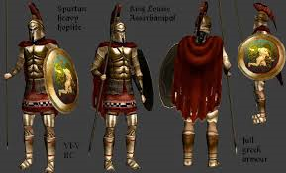
Spartan amour
The Spartans were one of the most armed army in ancient Greece. The only place where a Spartan hoplite can be hurt is his eyes. Spartan warriors Had a short sword, javelin, spear and a shield.
The armor and the shield was made of leather, wood and a coating of bronze.
They also had a dory. The dory was a 7-9 feet in length stich with a spear head on each side.

Slide 15
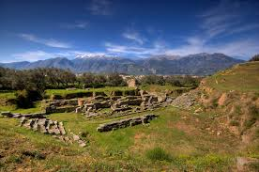
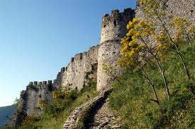
Spartan History
During the 5th century BC the Spartans were the most powerful city state because of their strength. All other city states want them on their side.
Before the Spartans started training and fighting only, they used to make beautiful sculptures out of bronze.
Sparta Today!
Today Sparta is a peaceful city just like all others, after the bloody conquest, the Spartans finally came to peace like a normal city state.

Slide 16
Ancient Spartan population
This is because many children were killed if they were not fit

Slide 17
6 reasons why being a Spartan was hard
Spartans had to prove their fitness as children
They had a military education program
fighting was encouraged between children
everyone was a lifetime solider
you had to find your own food
Surrender was a big shame in Sparta

Slide 18
Quick facts
Spartans were not interested in business, they only wanted to be tough and fit.
The Greeks used iron bars instead of coins.
Spartans were proud of their long hair and combed it before going to battle.
Spartans wore red cloaks so that blood stains would not show.
Eurytus was a warrior in the Thermopylae war who could not see, so he ordered his slave to lead him into battle.

Slide 19
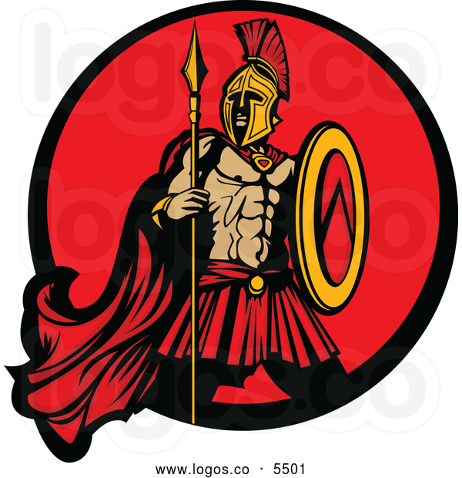
Even though the Spartans, had their own unique ways and were very violent..
They did help stop the invasion of Greece.

Slide 20
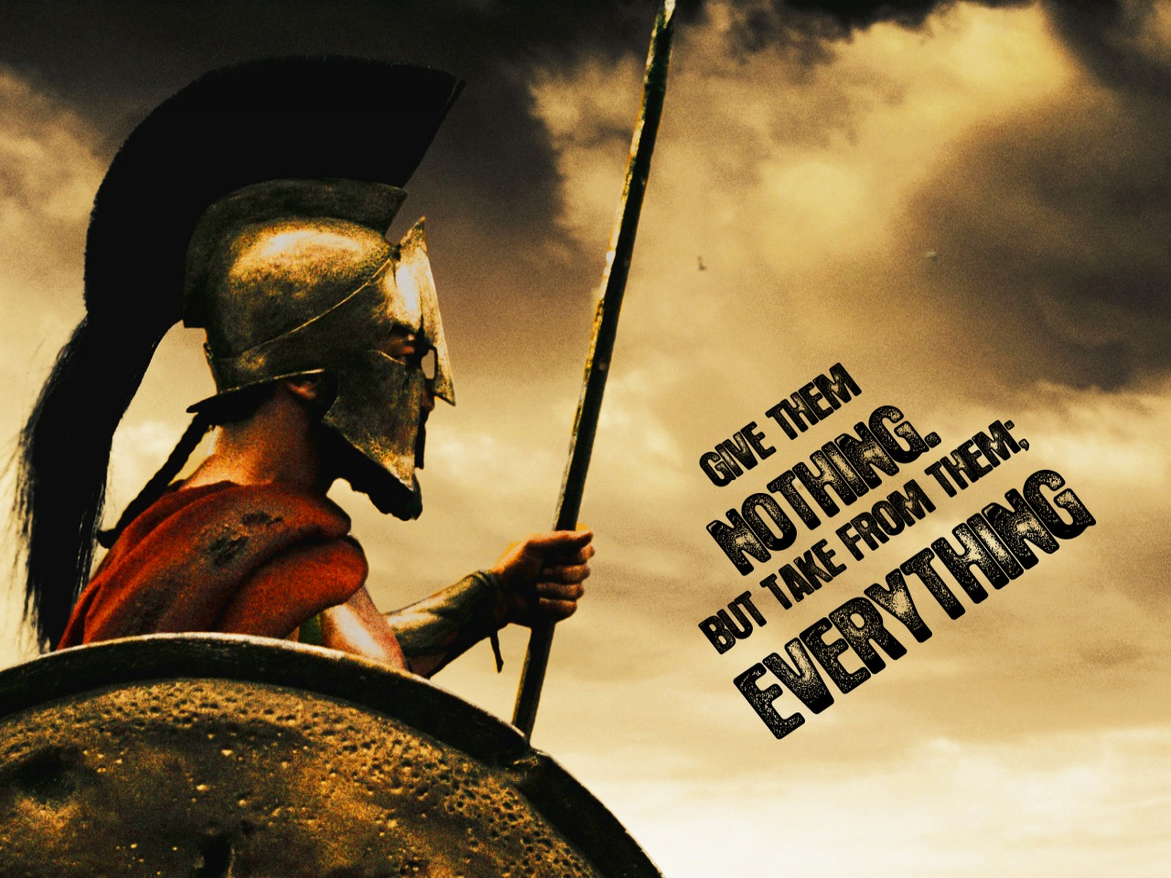

Slide 21
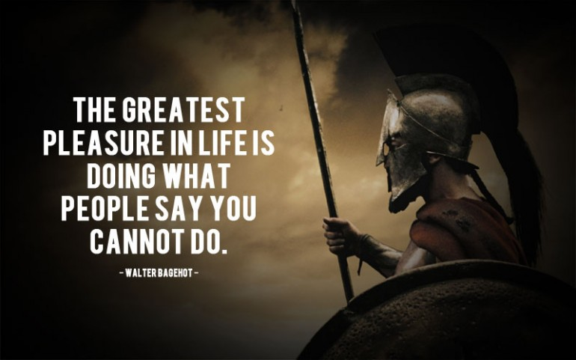

Slide 22
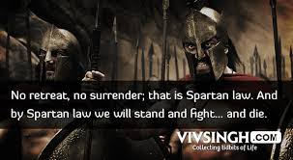

Slide 23
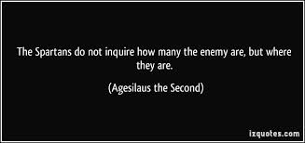

Slide 24
What do you think?
Why were the Spartans so violent and lived that way?
Who worked harder, the slaves of Sparta or Athens?

Slide 25
If Sparta was not always into military, then why did they change their education program?
The answer is in this link:
http://www.ancientgreece.co.uk/sparta/story/sto_set.html

Slide 26
bibliography
http://www.britannica.com/EBchecked/topic/558311/Sparta
http://en.wikipedia.org/wiki/Sparta
http://greece.mrdonn.org/sparta.html
http://www.ancient.eu.com/sparta/
http://www.sparta.net/
http://ancienthistory.about.com/cs/sparta/a/spartamilitstat.htm
http://www.livescience.com/32035-sparta.html
http://www.ancientgreece.co.uk/sparta/challenge/cha_set.html
http://www.ancientgreece.co.uk/sparta/home_set.html
http://www.ancientgreece.com/s/Geography/
http://www.history.com/news/history-lists/8-reasons-it-wasnt-easy-being-spartan

Slide 27
Bibliography
http://www.ancientgreece.com/s/Geography/
Horrible histories Groovy Greeks written by Terry Deary and illustrated by Martin Brown. Published in the UK scholastic at 2007. Reprinted in India at 2013.
The ancient Greek Olympics written by Richard Woff. Published in 1999, by the British museum. (I borrowed just a quote)
http://mp3truck.net/play/a1YxMTVLblRrWlE-221/soundtrack-theme-for-the-300-spartans-tribute-music-made-by-andre-tollenaar.html
http://www.wallsave.com/wallpapers/1280x960/300/434849/spartans-434849.jpg
http://www.mrwallpaper.com/wallpapers/spartan-warrior-1280x720.jpg

Slide 28
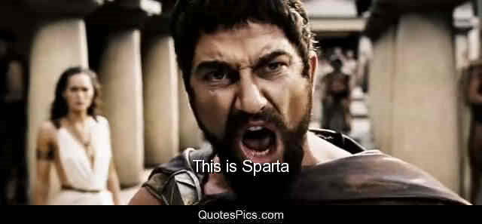
!!!

Slide 29
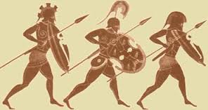
Photo Gallery
Thank you for your attention!

Slide 30
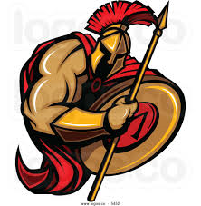
Wait…
Any questions?

